Slide 1
Lecture 4
Practical Aspects of Electronic Structure

Slide 2
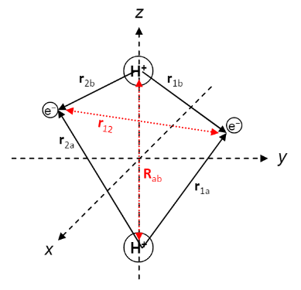
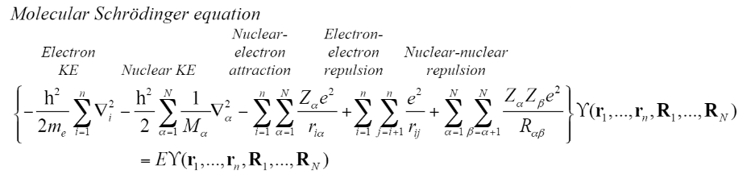
Molecular Scale Interactions
Differences in atomic vs. molecular eqn:
Nuclear KE
Nuclear-nuclear repulsions
Wavefunction depends on nuclear coordinates.

Slide 3
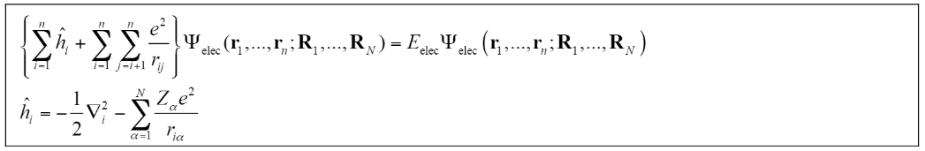
Reducing the Molecular Schrödinger Equation
Born-Oppenheimer Approximation:
Can reduce the molecular Schrödinger equation to single electron equations.
Have repulsions between all nuclei and each electron. Set up a new problem using orbitals like before.

Slide 4


Setting up the Problem
Can have many sets of equations if we have large molecules. Need to simplify.
Problem Set up:
Approximate wavefunction as product of basis sets.
Apply Variational Principle to get set of one atom equations.
Energy < E,ground
Take dE/dC = 0 and solve

Slide 5



Setting up the Problem
The Roothaan equation from the variational principle depend on the basis set.
Derived in a way similar to how we got the Secular equations. Before solving, it is convenient to rewrite this equation in terms of charge density rather than basis coefficients.
S = overlap integral
F = Fock matrix =
Two electron integrals representing electron-electron interactions

Slide 6
General Solution Method
1. Choose the basis set and charge density to evaluate the Roothaan equation.
2. Self-iteratively solve by checking the energy, E_{j}, of each iteration with previous E_{j-1}. Change charge density, P each iteration.
3. Solution reached when some tolerance of E is achieved.
Different solution methods will evaluate the one and two electron terms differently. HF treats the exchange integral exactly while HFS approximates it.

Slide 7
Simplifications
Semi-Empirical Methods:
-Extended Huckel Theory
-Complete Neglect of Differential Overlap
-Neglect of Diatomic Differential Overlap
Molecule Symmetry:
-For symmetrical molecules, the Fock matrix is often reduced due to pi bond or sigma bond symmetry.
Fits some parts of the Fock matrix to experimental data to reduce the problem size.

